Slide 1
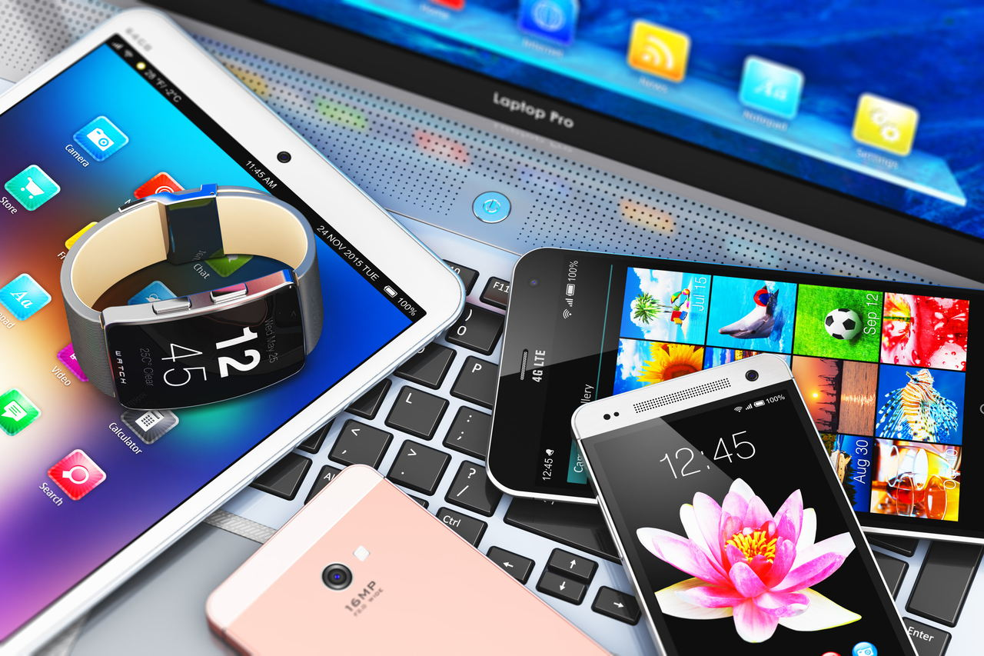
Electronic devices

Slide 2
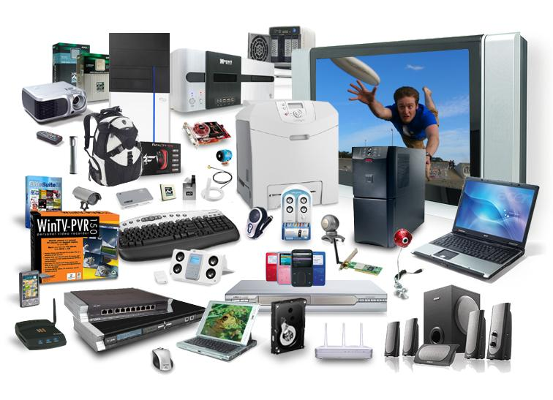
Electronic definition
The device which controls the flow of electrons is called electronic device. These devices are the main building blocks of electronic circuits.
Electronics have various branches include, digital electronics, analog electronics, micro electronics, nanoelectronics, optoelectronics, integrated circuit and semiconductor device.

Slide 3
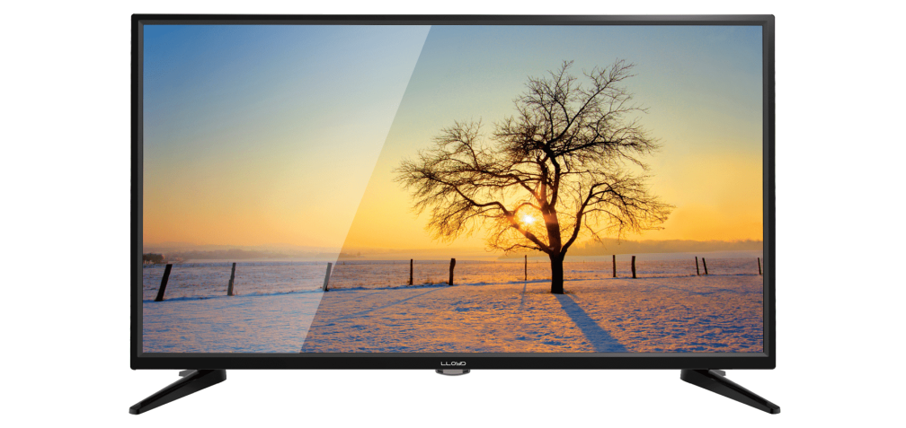
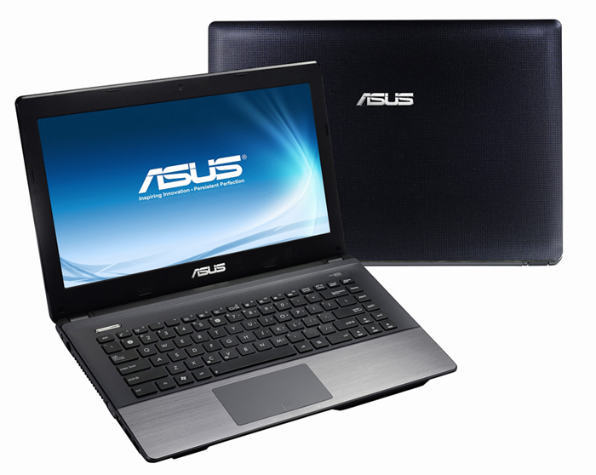
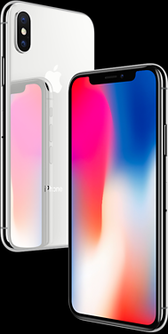
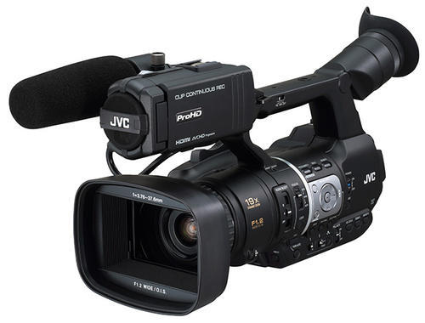
Example of electronic devices
television
laptop
tetelephone
camera

Slide 4



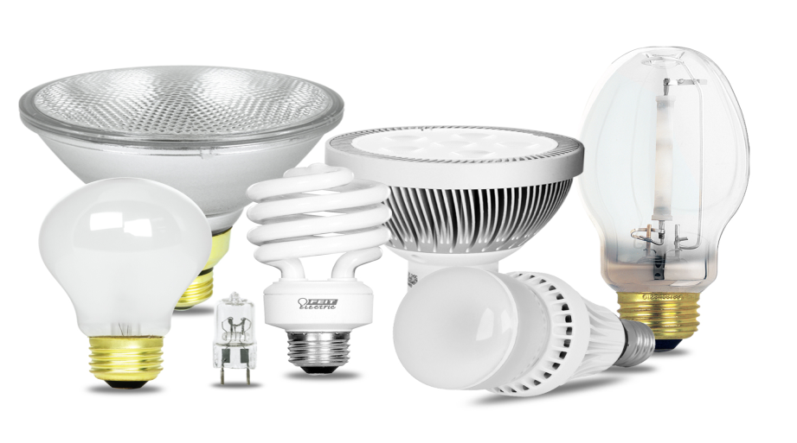
playstation
oven
hair straightener
Electronic lamp

Slide 5
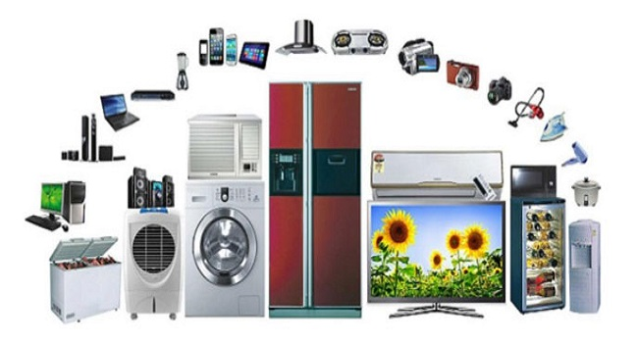
Advantages
Easy Access to information
Encourages innovation and creativity
Improved communication
Convenience of Traveling
Improved housing and lifestyle
Improved Entertainment
Efficiency and Productivity
Convenience in Education
Social Networking
Changed the heath industry

Slide 6

Disadvantages
Increased loneliness
Job loss
Competency
World destruction weapons

Slide 7
Increased Loneliness
Social Isolation is on the increase, people are spending more time playing video games, learning how to use new modern technologies, using social networks and they neglect their real life
Technology has replaced our old way of interacting
If the user can easily interact with 100 friends online,they will feel no need to going out to make real friends which at a later stage leads to loneliness

Slide 8


